Slide 1
Exploring functional roles of non-coding RNA in stony corals
Kathleen Durkin, Sam White, Jill Ashey, Javier Rodriguez Casariego, Zach Bengtsson, Ariana Huffmyer, Danielle Becker, Jose Eirin-Lopez, Hollie Putnam, Steven Roberts

Slide 2
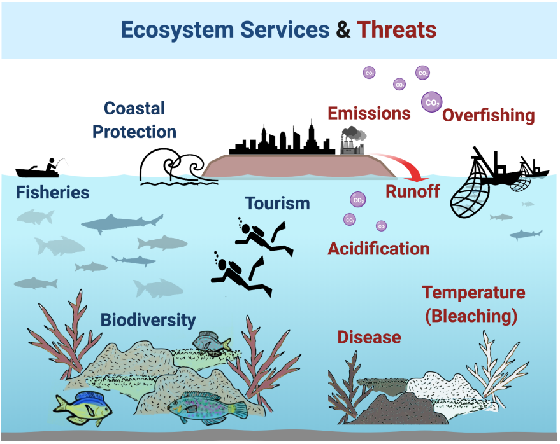
Rivera et al., 2020
Notes:
Corals are really ipmortant and imperiled by anthropogenic disturbance climate change
We still don’t know much about the genetic and epigenetic mechanisms that underlie environmental response.
E5 project working to evaluate mechanisms of environmental response accross many levels. Today I’ll be talking about some components of our molecular work

Slide 3
Organismal Resilience
Rivera et al., 2020
Notes:
Corals are really ipmortant and imperiled by anthropogenic disturbance climate change
We still don’t know much about the genetic and epigenetic mechanisms that underlie environmental response.
E5 project working to evaluate mechanisms of environmental response accross many levels. Today I’ll be talking about some components of our molecular work

Slide 4
Organismal Resilience
What are the molecular mechanisms involved in effective physiological responses to environmental conditions?
Rivera et al., 2020
Notes:
Corals are really ipmortant and imperiled by anthropogenic disturbance climate change
We still don’t know much about the genetic and epigenetic mechanisms that underlie environmental response.
E5 project working to evaluate mechanisms of environmental response accross many levels. Today I’ll be talking about some components of our molecular work

Slide 5
Organismal Resilience
What are the molecular mechanisms involved in effective physiological responses to environmental conditions?
How consistent are these within and across species?
Rivera et al., 2020
Notes:
Corals are really ipmortant and imperiled by anthropogenic disturbance climate change
We still don’t know much about the genetic and epigenetic mechanisms that underlie environmental response.
E5 project working to evaluate mechanisms of environmental response accross many levels. Today I’ll be talking about some components of our molecular work

Slide 6
Organismal Resilience
What are the molecular mechanisms involved in effective physiological responses to environmental conditions?
How consistent are these within and across species?
Is there a non-genetic heritable component of resiliency?
Rivera et al., 2020
Notes:
Corals are really ipmortant and imperiled by anthropogenic disturbance climate change
We still don’t know much about the genetic and epigenetic mechanisms that underlie environmental response.
E5 project working to evaluate mechanisms of environmental response accross many levels. Today I’ll be talking about some components of our molecular work

Slide 7
Organismal Resilience
What are the molecular mechanisms involved in effective physiological responses to environmental conditions?
How consistent are these within and across species?
Is there a non-genetic heritable component of resiliency?
Rivera et al., 2020
Notes:
Corals are really ipmortant and imperiled by anthropogenic disturbance climate change
We still don’t know much about the genetic and epigenetic mechanisms that underlie environmental response.
E5 project working to evaluate mechanisms of environmental response accross many levels. Today I’ll be talking about some components of our molecular work

Slide 8
Functional roles of non-coding RNAs
Talk Outline
What are the molecular mechanisms involved in effective physiological responses to environmental conditions?
Characterize the relationship of miRNA and genes in A. pulchra.
Explore the relationship of of miRNA, genes, and lncRNAs.
Rivera et al., 2020
Notes:
Corals are really ipmortant and imperiled by anthropogenic disturbance climate change
We still don’t know much about the genetic and epigenetic mechanisms that underlie environmental response.
E5 project working to evaluate mechanisms of environmental response accross many levels. Today I’ll be talking about some components of our molecular work

Slide 9
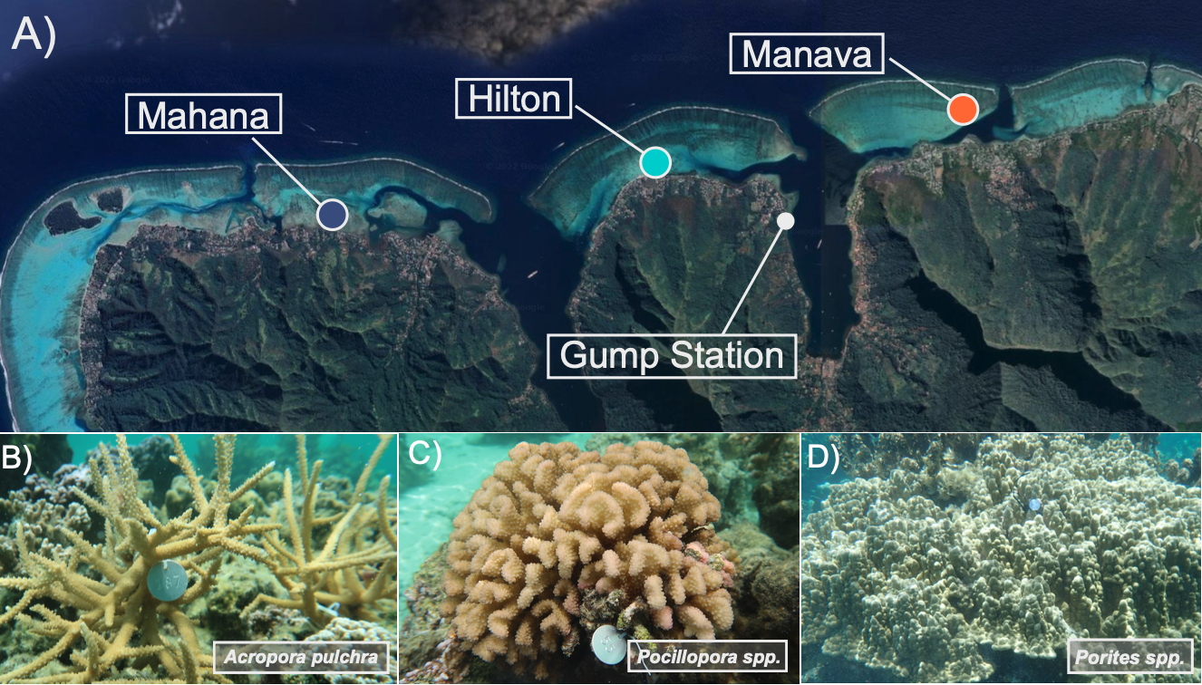
Experimental System
Samples from Moorea, French Polynesia
Analysis is on A. pulchra (40 samples across time and sites)

Slide 10
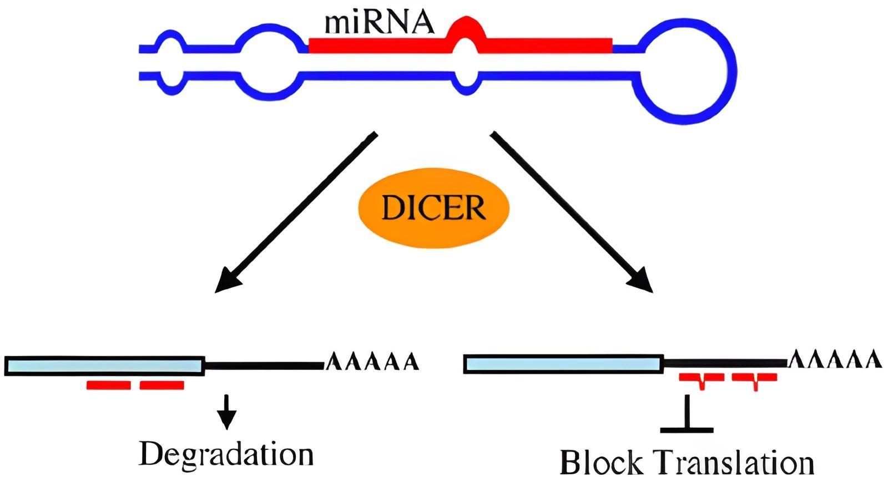
Vella & Slack, 2005
Notes:
miRNAs are a class of non-coding RNAs, which are not translated into protein but still influence gene expression.
miRNAs specifically are characterized by their length (~22n) and characteristic structure.
miRNAs canonically operate as such: A precursor miRNA is processed down into it’s mature miRNA, which is then loaded into an Argonaute protein complex. The miRNA then binds to a target RNA, taking its protein complex with it. Once bound, the complex either recruits cellular machinery to either degrade the RNA or blocks the translation of that RNA into protein.

Slide 11
Vella & Slack, 2005
Notes:
miRNAs are a class of non-coding RNAs, which are not translated into protein but still influence gene expression.
miRNAs specifically are characterized by their length (~22n) and characteristic structure.
miRNAs canonically operate as such: A precursor miRNA is processed down into it’s mature miRNA, which is then loaded into an Argonaute protein complex. The miRNA then binds to a target RNA, taking its protein complex with it. Once bound, the complex either recruits cellular machinery to either degrade the RNA or blocks the translation of that RNA into protein.

Slide 12
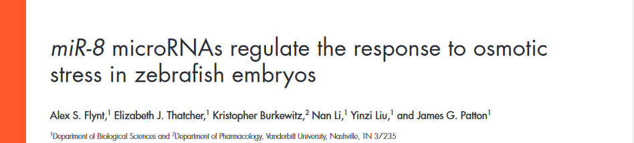
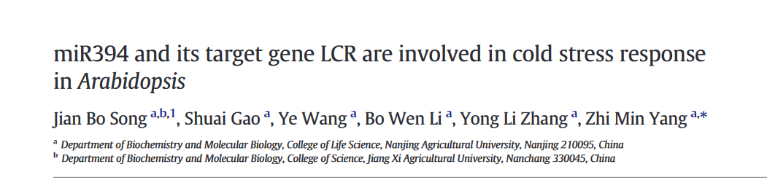
2009
2016
Notes:
Knockdown of the miR-8 miRNA family renders zebrafish embryos unable to respond to osmotic stress (Flynt et al., 2009)
In Arabidopsis, miR394a overexpressing plants exhibited more tolerance to cold stress (Song et al. 2016)
Look for environmentally responsive miRNAs in corals!

Slide 13
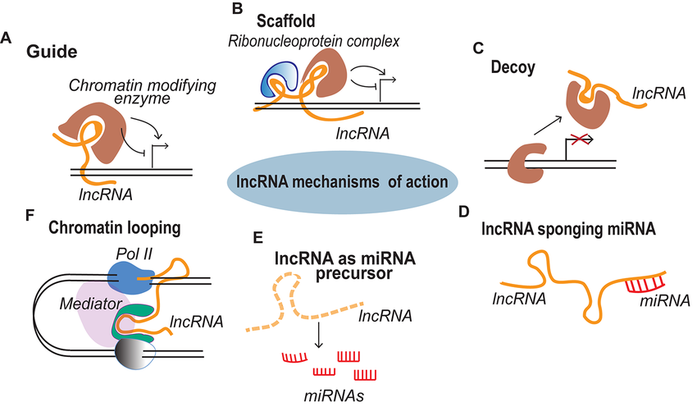
Vella & Slack, 2005
Notes:
miRNAs are a class of non-coding RNAs, which are not translated into protein but still influence gene expression.
miRNAs specifically are characterized by their length (~22n) and characteristic structure.
miRNAs canonically operate as such: A precursor miRNA is processed down into it’s mature miRNA, which is then loaded into an Argonaute protein complex. The miRNA then binds to a target RNA, taking its protein complex with it. Once bound, the complex either recruits cellular machinery to either degrade the RNA or blocks the translation of that RNA into protein.

Slide 14
Functional roles of non-coding RNAs
Talk Outline
Characterize the relationship of miRNA and genes in A. pulchra.
Explore the relationship of of miRNA, genes, and lncRNAs.
Rivera et al., 2020
Notes:
Corals are really ipmortant and imperiled by anthropogenic disturbance climate change
We still don’t know much about the genetic and epigenetic mechanisms that underlie environmental response.
E5 project working to evaluate mechanisms of environmental response accross many levels. Today I’ll be talking about some components of our molecular work

Slide 15
Are our miRNAs and genes directly related?

Slide 16
Are our miRNAs and genes directly related?

Slide 17
Are our miRNAs and genes directly related?
miRNA-3’UTR binding
change in expression

Slide 18
Are our miRNAs and genes directly related?
miRNA-3’UTR binding miRanda
change in expression Pearson’s correlation

Slide 19
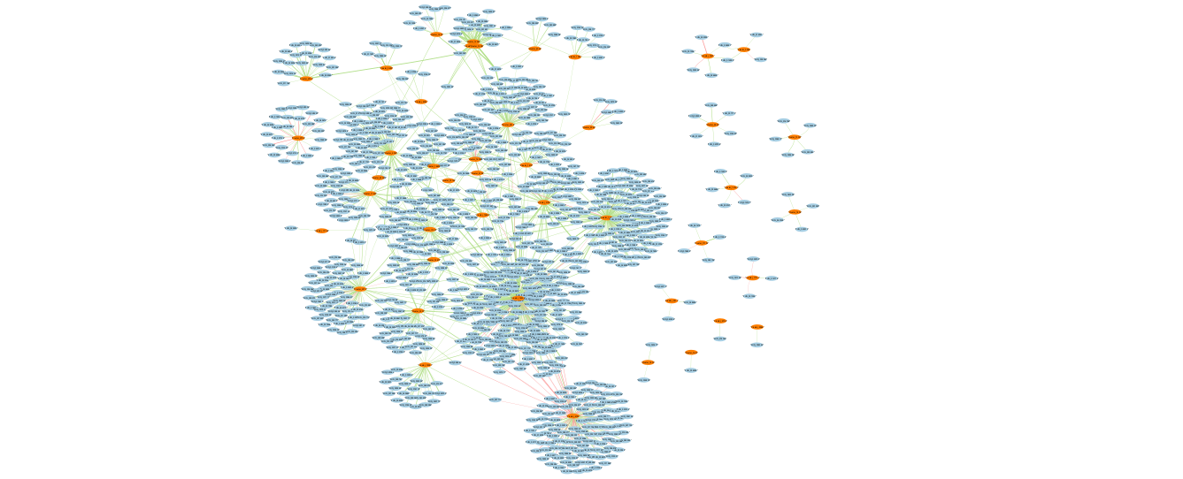
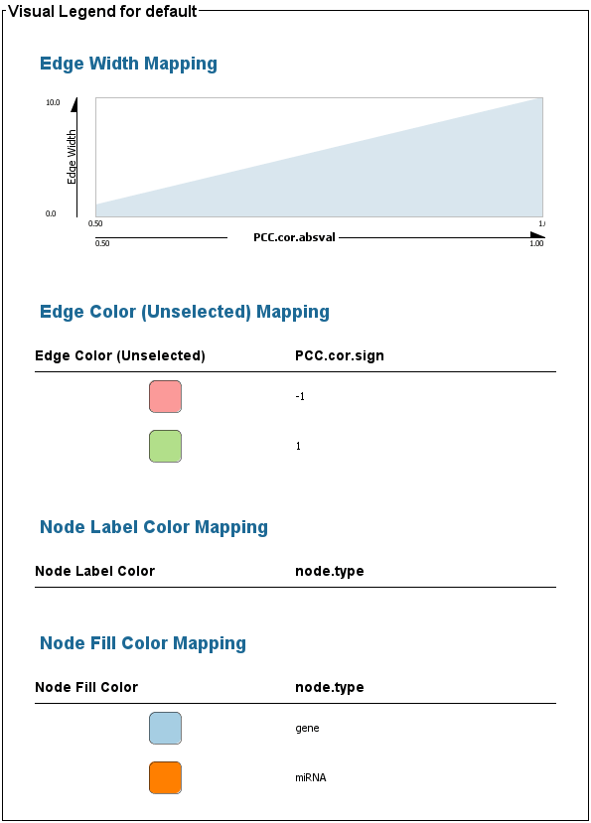
miRanda target prediction
Pearson’s correlation (p < 0.001; |cor| > 0.5)
44 miRNAs
1058 genes
miRNA
gene
correlation sign
+
-
Notes:
44 miRNAs show significant interaction (binding + coexpression) with a total of 1058 mRNA

Slide 20
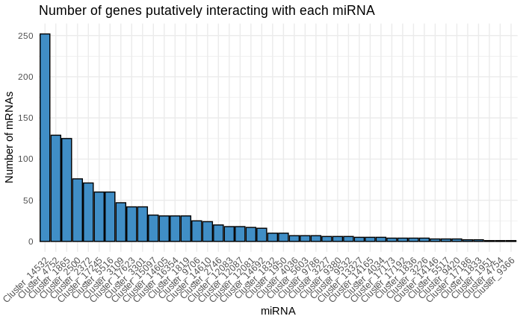
miRNAs interact with variable numbers of genes

Slide 21
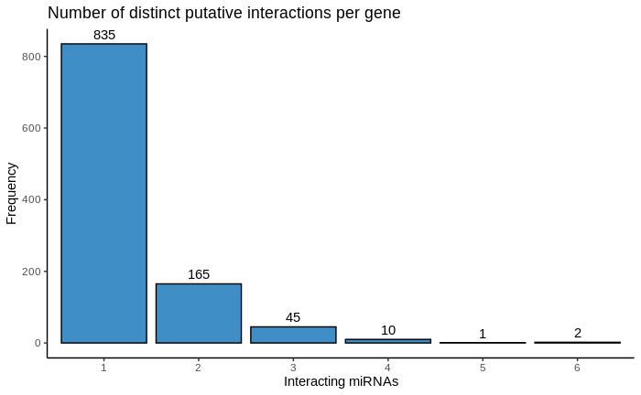
Most genes interact with a single miRNA

Slide 22
miRanda target prediction
Pearson’s correlation (p < 0.001; |cor| > 0.5)
44 miRNAs
1058 genes
miRNA
gene
correlation sign
+
-
Notes:
44 miRNAs show significant interaction (binding + coexpression) with a total of 1058 mRNA

Slide 23
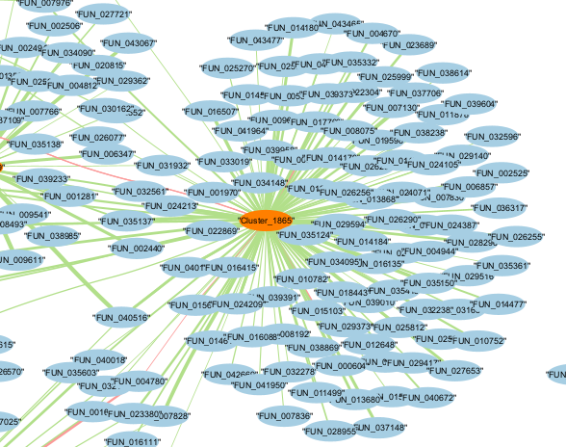
miRNA “Cluster 1865”
Functionally enriched for immune regulation terms, specifically interleukin-1 beta (IL-1β), a pro-inflammatory cytokine.
Notes:
Cluster 1865 interacts with genes that are enriched for immune regulation terms, specifically the interleukin-1 beta (IL-1β), a pro-inflammatory cytokine. This suggests Cluster 1865 may play a role in immune response

Slide 24
miRanda target prediction
Pearson’s correlation (p < 0.001; |cor| > 0.5)
44 miRNAs
1058 genes
miRNA
gene
correlation sign
+
-
Notes:
44 miRNAs show significant interaction (binding + coexpression) with a total of 1058 mRNA

Slide 25
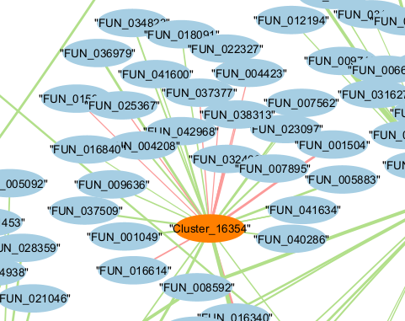
miRNA “Cluster 16354”
Differentially expressed miRNA across timepoints
(TP1 v. TP2, TP4 v. TP2)
Functionally enriched for one biological process: Growth regulation
Notes:
Cluster 16354 is of particular interest because it's the only miRNA I identified as differentially expressed over time (note, this may change as i learn how to adjust expression methods for the small number of miRNAs). The set of genes that Cluster 16354 interacts with is enriched for one biological process, Growth Regulation. This suggests Cluster 16354 may be involved in regulating growth in response to environmental signals.

Slide 26
Functional roles of non-coding RNAs
Talk Outline
Characterize the relationship of miRNA and genes in A. pulchra.
Explore the relationship of of miRNA, lncRNAs, and genes.
Rivera et al., 2020
Notes:
Corals are really ipmortant and imperiled by anthropogenic disturbance climate change
We still don’t know much about the genetic and epigenetic mechanisms that underlie environmental response.
E5 project working to evaluate mechanisms of environmental response accross many levels. Today I’ll be talking about some components of our molecular work

Slide 27
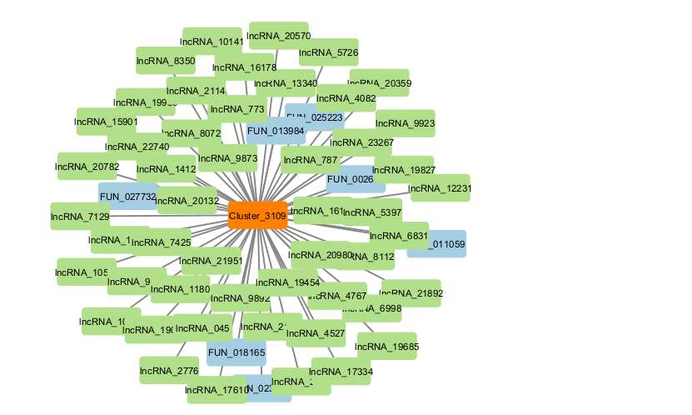
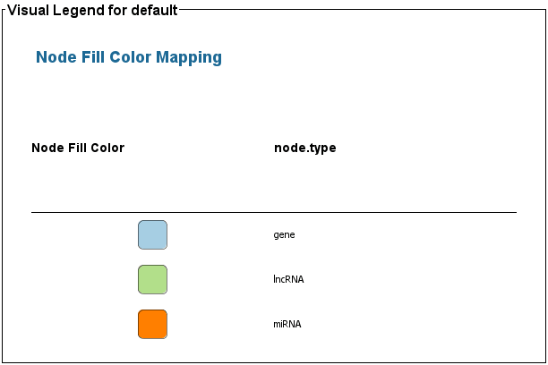
Incorporating co-expressed lncRNAs
miRNA
gene
lncRNA

Slide 28
Incorporating co-expressed lncRNAs
Unique miRNA-lncRNA Interactions:
5 miRNAs are only coexpressed with lncRNA
Co-regulated miRNA-Gene and miRNA-lncRNA Pairs:
18 miRNAs are significantly correlated with both genes and lncRNAs
Potential lncRNAs Acting as miRNA Sponges:
5 miRNAs have very highly correlated lncRNA expression AND strong gene correlations.

Slide 29
Summary of Findings
Talk Outline
In A. pulchra…
miRNAs, lncRNAs, and genes are related in complex network of correlated expression. Most miRNAs putatively target and are correlated with genes, many correlate with lncRNAs
Some miRNAs are only correlated with lncRNAs
Differential expression and functional enrichment suggests some miRNAs are environmentally responsive
Characterize the relationship of miRNA and genes in A. pulchra.
Explore the relationship of of miRNA, lncRNAs, and genes.
Highlight implications and future directions.
Rivera et al., 2020
Notes:
Corals are really ipmortant and imperiled by anthropogenic disturbance climate change
We still don’t know much about the genetic and epigenetic mechanisms that underlie environmental response.
E5 project working to evaluate mechanisms of environmental response accross many levels. Today I’ll be talking about some components of our molecular work

Slide 30
Future work
lncRNAs
Associations with physiology, metabolomics data
DNA methylation data (WGBS)
Three species!

Slide 31








Acknowledgements
Roberts
Lab
Steven Roberts
Sam White
Jill Ashey
Ariana Huffmeyer
E5 Coral molecular working group
Roberts Lab
Hollie Putnam
Kerry Naish
SICB Charlotte Mangum Housing Award
ARCS Foundation
NSF Award Numbers: 1921465, 1921149, 1921425, 1921356, 1921402

Slide 32
References
Vella, M.C. and Slack, F.J. C. elegans microRNAs (September 21, 2005), WormBook, ed. The C. elegans Research Community, WormBook, doi/10.1895/wormbook.1.26.1, http://www.wormbook.org.

Slide 33
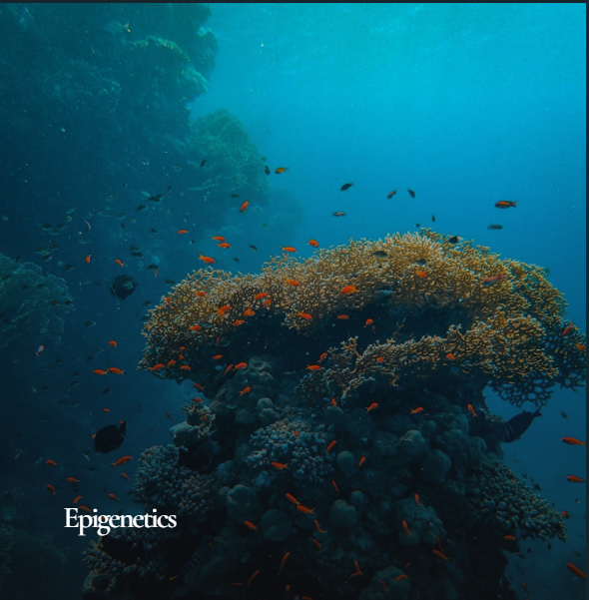
Color Scheme:
Dark (#0a1e29)
Dark (#023f54)
Light (#fbfbfc)
Accent (#0a958b)
Accent (#77978e)
Accent (#82825c)
Accent (#a22f06)
Accent (#8e6b33)

Slide 34
Fig 1. Study design. (A) Three sites (Mahana, Hilton, Manava) were established in October 2019 by transplanting in 10 colonies of (B) Acropora pulchra colonies and tagging 15 colonies of C) Pocillopora spp. and D) Porites spp. at each site. Colonies were sampled in January, March, September, and November of 2020.

Slide 35
Hypotheses
Conserved miRNAs are more highly expressed on average
miRNA primarily bind to the mRNA 3’UTR
miRNA-mRNA predicted binding is associated with coexpression
siRNAs are associated with transposon silencing
Some lncRNAs act as miRNA precursors (lncRNA contains multiple pre-miRNAs, expression levels are positively related)
Some lncRNAs act as miRNA sponges (miRNA binds to lncRNA, expression levels are negatively related)
As in other marine invertebrates, differential methylation patterns (DMPs) are not associated with differential gene expression
DMPs are associated with gene expression variability/transcriptional noise
siRNA expression is associated with differential methylation

Slide 36
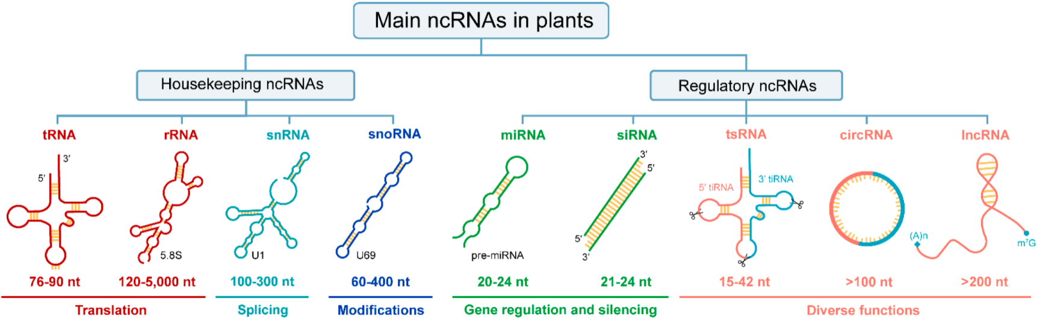
Non-coding RNAs (ncRNAs)
Micro RNA (miRNA) – myriad gene expression regulation
Long non-coding RNAs (lncRNAs) – diverse size, structure, and function, including as guide, scaffold, decoy, miRNA sponge, and miRNA precursor
Adapted from Chao et al. 2022

Slide 37
lncRNA - miRNA interactions
7 lncRNAs functioning as miRNA precursor, for 2 different miRNAs [need to confirm with coexpression]
Putative lncRNA sponges [need expression to confirm]
^ once have lncRNA-miRNA interactions, can associate with putative function

Slide 38
Cnidaria:
Less conserved
Fewer targets
Higher target complementarity
Vella & Slack, 2005
Notes:
miRNAs are a class of non-coding RNAs, which are not translated into protein but still influence gene expression.
miRNAs specifically are characterized by their length (~22n) and characteristic structure.
miRNAs canonically operate as such: A precursor miRNA is processed down into it’s mature miRNA, which is then loaded into an Argonaute protein complex. The miRNA then binds to a target RNA, taking its protein complex with it. Once bound, the complex either recruits cellular machinery to either degrade the RNA or blocks the translation of that RNA into protein.

Slide 39
Methods
[Diagram figure of data analysis pipeline]
miRNA identification through ShortStack
miRNA-mRNA target prediction performed using miRanda
miRNA-mRNA coexpression evaluated using Pearson’s correlation coefficient
Notes:
cut?

Slide 40
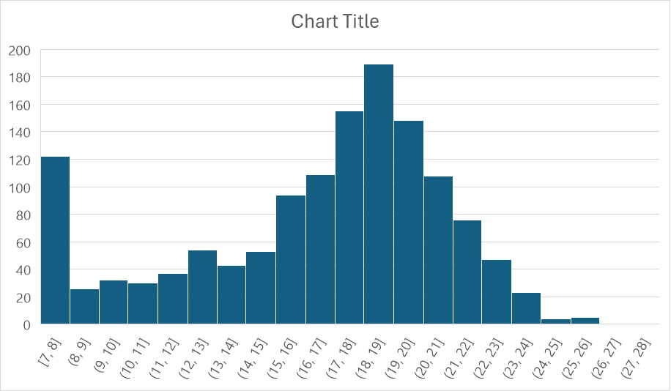
Are our miRNAs and genes directly related?
Binding-coexpression interaction network (if I can get correlations)
WGCNA modules and compare with binding (e.g. if module contains miRNA, does that miRNA bind with other genes in the same module?)
Interesting sidenote:
Significant interactions suggest that A.pulchra miRNAs exhibit both binding “strategies”: seed binding (the 7-8bp spike) and more complete complementarity of the entire mature miRNA (hump in the 16-24bp range)

Slide 41
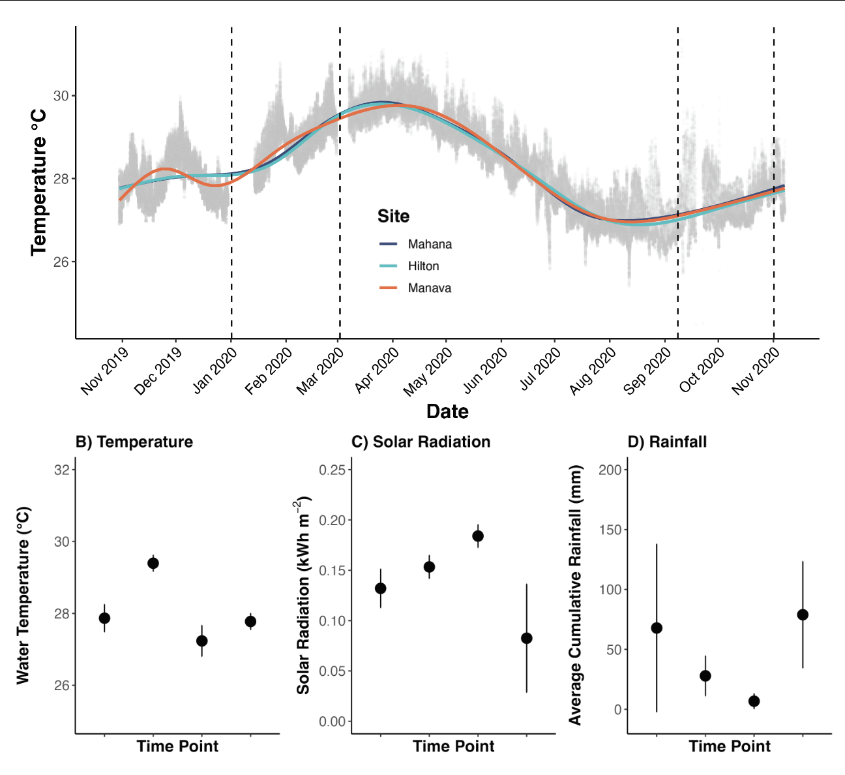
Data Collection
Sampled at 4 time points over course of one year
(January, March, September, and November 2020)
RNAseq and sRNAseq
Notes:
Point out that environmental variables are not strictly related to each other over time (i.e. pattern over time of temperature looks very different from pattern of rainfall)

Slide 42
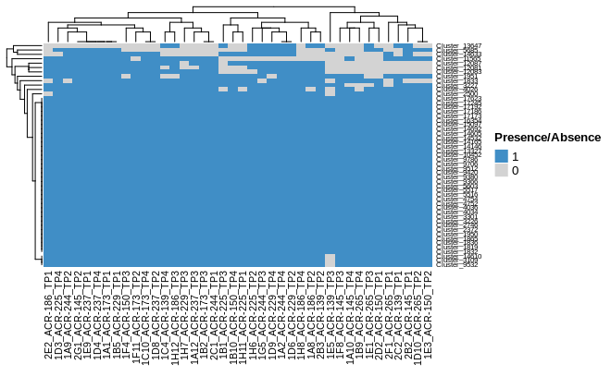
ShortStack for miRNA ID
51 unique miRNA
31 previously described

Slide 43
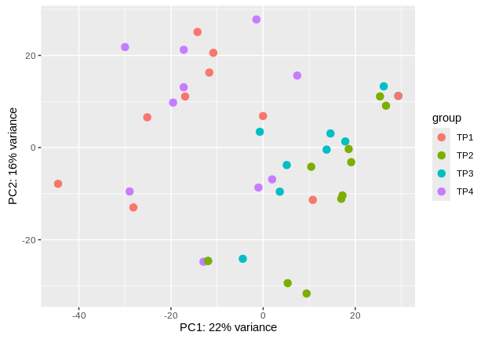
Gene expression clusters by timepoint
PCA of variance stabilized gene counts

Slide 44
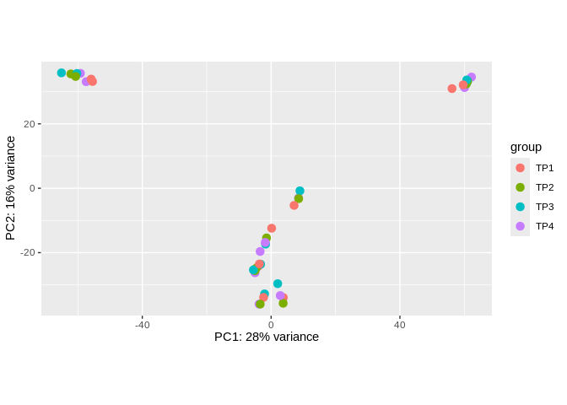
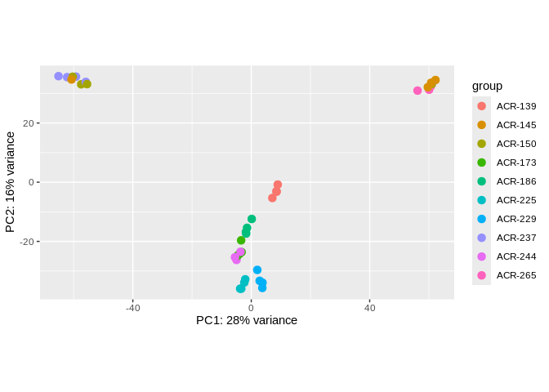
sRNA expression clusters by colony..
PCA of variance stabilized counts (all sRNA)

Slide 45
sRNA expression clusters by colony..
PCA of variance stabilized counts (all sRNA)

Slide 46
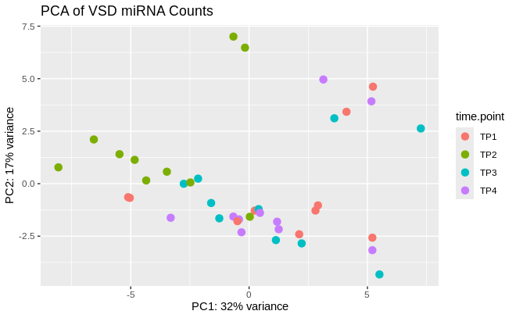
But miRNA expression clusters by timepoint!
PCA of variance stabilized counts (miRNA only)

Slide 47
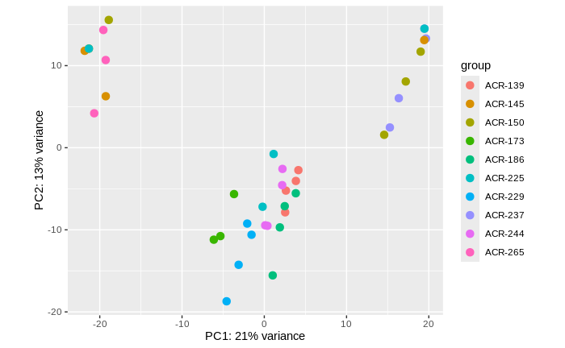
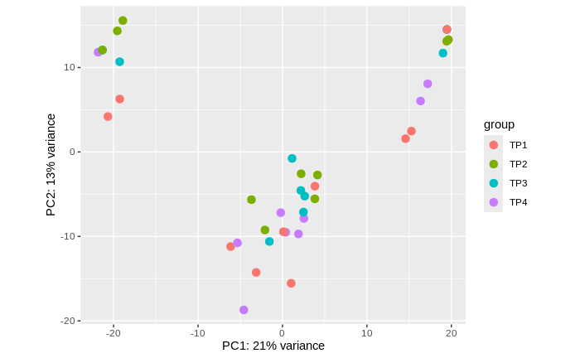
lncRNAs cluster similarly to sRNA
PCA of variance stabilized lncRNA counts

Slide 48
lncRNAs cluster similarly to sRNA
PCA of variance stabilized lncRNA counts

Slide 49
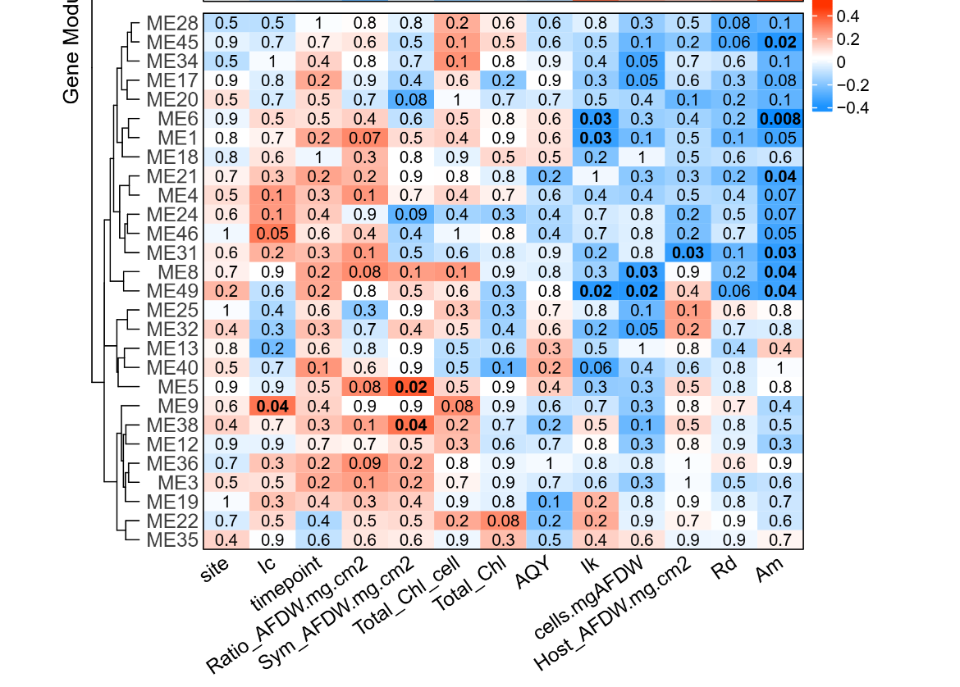
Use WGCNA to integrate physiological metrics

Slide 50
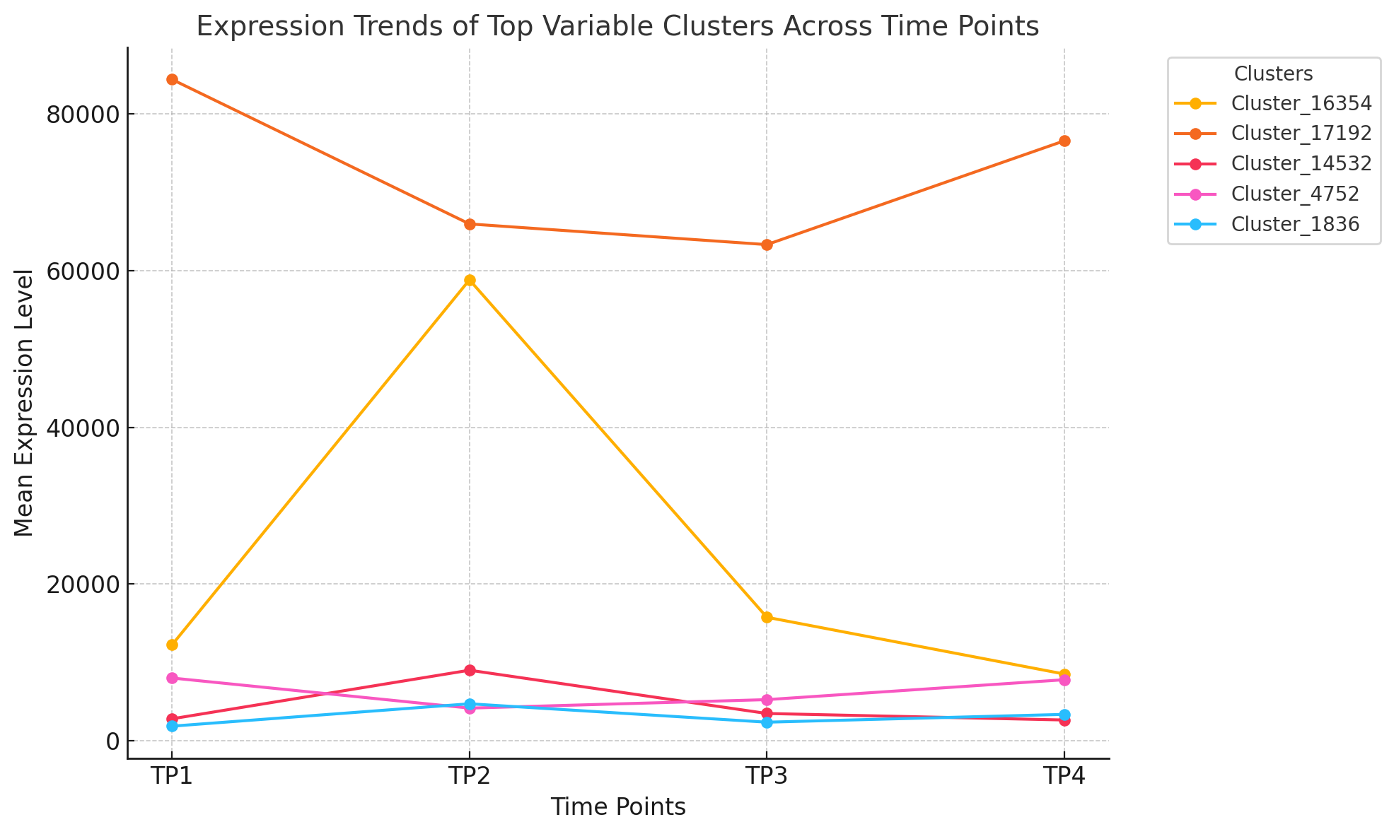
Top Variable miRNAs
• Cluster_16354: Exhibits the highest variability, likely contributing significantly to differences among time points.
• Cluster_17192: Also highly variable, indicating potential dynamic regulation or experimental differences.
• Cluster_14532 and Cluster_4752: Show considerable variability, though less than the top two clusters.
Figure

Slide 51
Functional roles of non-coding RNAs
Talk Outline
44 miRNAs putatively interact with 1058 genes.
miRNAs interact with a variable number of genes
most genes interact with only a single miRNA
miRNA function can be elucidated through functional annotation of interacting genes
Characterize the relationship of miRNA and genes in A. pulchra.
Explore the relationship of of miRNA, lncRNAs, and genes.
Rivera et al., 2020
Notes:
Corals are really ipmortant and imperiled by anthropogenic disturbance climate change
We still don’t know much about the genetic and epigenetic mechanisms that underlie environmental response.
E5 project working to evaluate mechanisms of environmental response accross many levels. Today I’ll be talking about some components of our molecular work

